Slide 1
Juvenile Justice:
Investigating Racial Disparities
Researchers: Darcely Peña and Elsa Hritz

Slide 2
Table of Contents
01
04
02
05
03
Research Questions
Next Steps
Dataset
Implications
Previous Research

Slide 3
Research Questions

Slide 4
Research Questions
How do social, economic, and demographic characteristics of a census tract relate to the number of juvenile probation referrals?
What demographic and offense-related factors can predict the race/ethnicity of a juvenile referred to Cumberland County’s probation office?
What are the key predictors of a juvenile's likelihood to recommit a crime? (time permitting)

Slide 5
Our Dataset

Slide 6
Our Dataset
Pennsylvania Case Management System:
2,319 referrals from 2012-2022
1,306 juveniles
Information on demographics, addresses, charges, dispositions, and prior counts
US Census - ACS:
Datasets: Demographic & Housing Estimates, Selected Economic Characteristics, Selected Social Characteristics
Pulled data from 2012-2022 for each survey on the census tract level and merged them all
Limitations:
2,719 expunged cases
Small sample sizes when analyzing census tracts
Notes:
Requested data from the Pennsylvania Juvenile Court Judges’ Commission (JCJC) and the Center for Juvenile Justice Training and Research
Purpose of request
Specific data request/description
Table of possible variables
Literature review
IRB approval

Slide 7
Data Cleaning
Merged four tables from the PCMS:
Cases
Disposed Charges
Dispositions
Demographics
Data Cleaning:
Dropped columns not relevant to our analysis and containing a lot of missing values
We are interested in the first disposition of each case and dropped subsequent dispositions
Dummy Data:
For categorical columns, randomly assign each record a value from a list of unique values in the column
For numerical columns, multiply the value by a randomly selected number in a given range

Slide 8
Previous Research

Slide 9
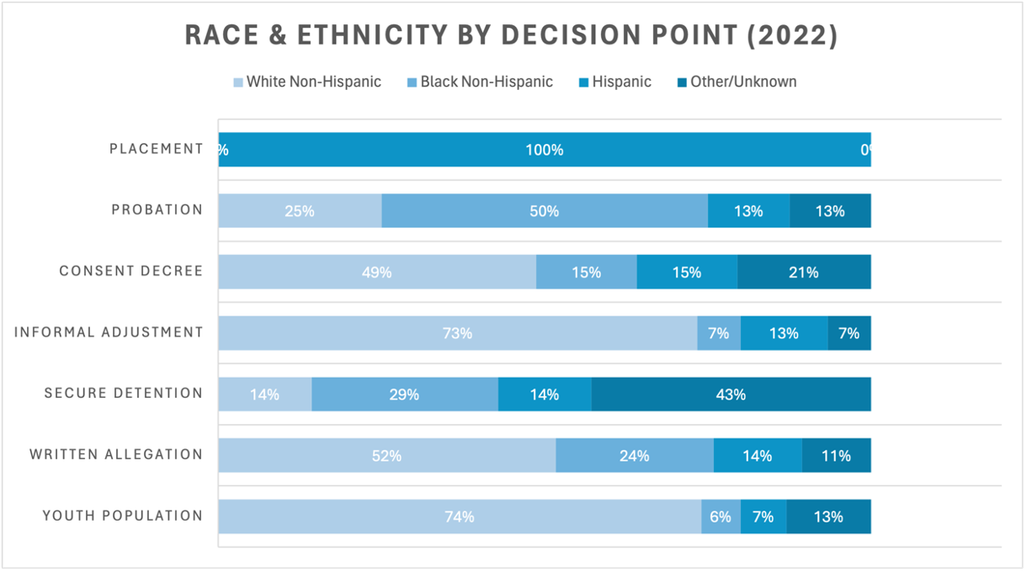
Race & Ethnicity by Decision Pt

Slide 10
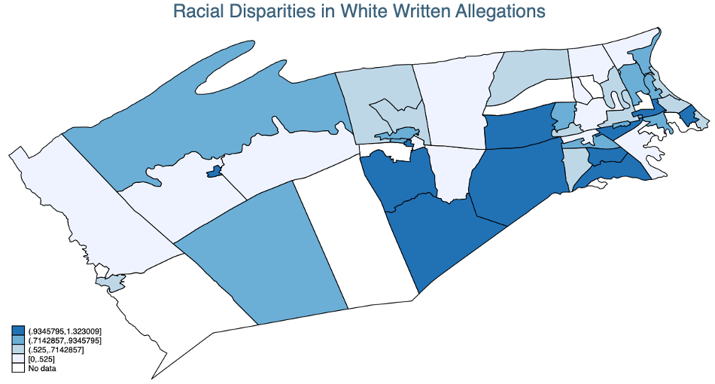
Racial Disparities in White Written Allegations
Census Tract | % of White Written Allegations | % of White Youth Population | Ratio
118.06 | 50% | 38% | 1.32
122 | 33% | 28% | 1.18
116.06 | 100% | 85% | 1.16
105 | 100% | 92% | 1.08
111.02 | 50% | 47% | 1.06

Slide 11
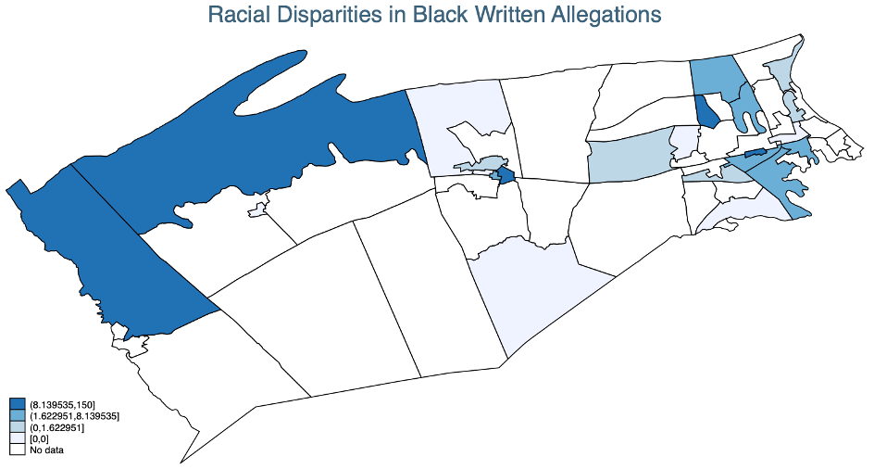
Racial Disparities in Black Written Allegations
Census Tract | % of Black Written Allegations | % of Black Youth Population | Ratio
131.03 | 50% | .3% | 150
121 | 37.5% | .8% | 42.38
130 | 16.67% | .5% | 27.96
112 | 33.33% | 2.11% | 15.75
113.03 | 28.57% | 4.82% | 5.92

Slide 12
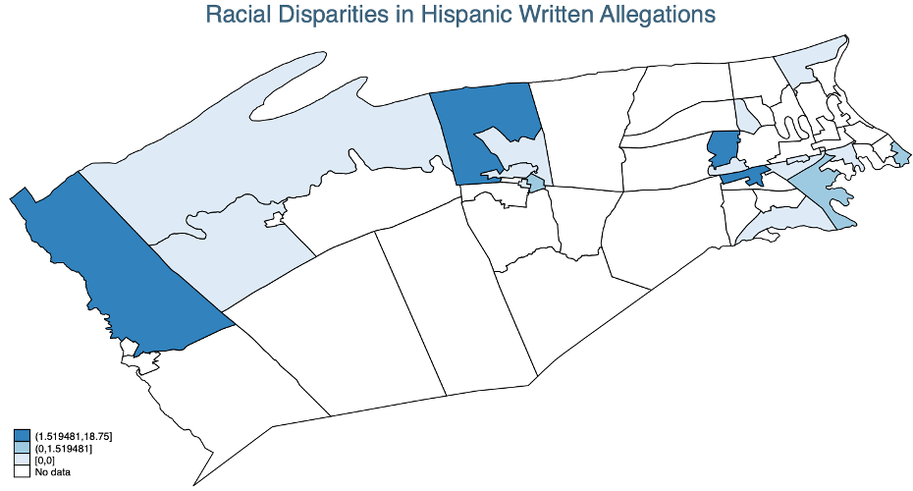
Racial Disparities in Hispanic Written Allegations
Census Tract | % of Hisp Written Allegations | % of Hisp Youth Population | Ratio
131.03 | 25% | 1.33% | 18.75
119.01 | 50% | 9.46% | 5.28
118.07 | 25% | 5.66% | 4.42
115 | 33.33% | 13.96% | 2.39
108 | 27.27% | 17.95% | 1.52

Slide 13
Overall Dispositional Outcomes by Race & Ethnicity
Dispositional Outcomes | Black non-Hispanic | White non-Hispanic | Hispanic | Others
Post-adjudication Outcome | 22.08% | 25.97% | 24.62% | 24.38%
Probation | 17.53% | 20.92% | 18.46% | 21.25%
Placement | 4.55% | 4.47% | 5.13% | 3.13%
Others | 0.00% | 0.58% | 1.03% | 0.00%
Non-adjudication Outcome | 77.92% | 74.03% | 75.38% | 75.63%
Intake | 41.23% | 36.22% | 37.95% | 30.63%
Consent Decree | 17.21% | 19.05% | 16.92% | 29.38%
Informal | 4.87% | 10.10% | 7.18% | 5.63%
Others | 14.61% | 8.66% | 13.33% | 10.00%
Number of Cases | 308 | 693 | 195 | 160

Slide 14
Racial Disparities in Post-Adjudication Action: Probation
Race per 1,000 population | White non-Hispanic | Black non-Hispanic | Hispanic
Mean Proportion | 1.84 | 15.25 | 4.64
Race Disparity (Race X's Proportion/White Proportion) | Black non-Hispanic | Hispanic
Mean Ratio | 5.76 | 3.09

Slide 15
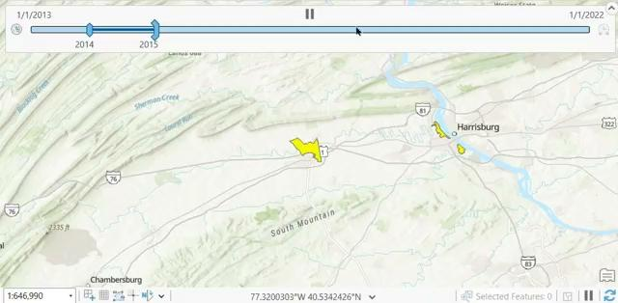
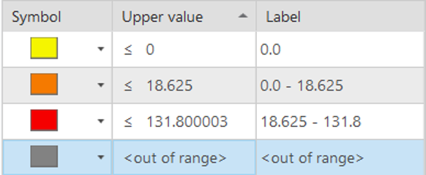
Race Disparities in Probation, Black vs White

Slide 16
Racial Disparities in Post-Adjudication Action:
Consent Decree
Race per 1,000 population | White non-Hispanic | Black non-Hispanic | Hispanic
Mean Proportion | 1.00 | 14.22 | 5.42
Race Disparity (Race X's Proportion/White Proportion) | Black non-Hispanic | Hispanic
Mean Ratio | 14.09 | 1.95

Slide 17
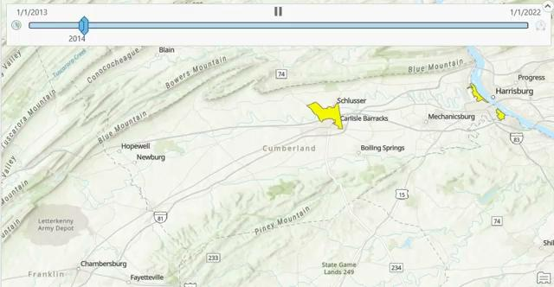
Racial Disparities in Consent Decree:
Hispanic vs White

Slide 18
Model

Slide 19
Next Steps (Model)
Random Forest: Predict number of probation referrals in a census tract based on its characteristics
Linear Classification and/ or random forest: to predict the race of someone that receives a referral with the intent on determining the most impactful decision factors
Potentially model the likelihood of a given juvenile re-committing a crime

Slide 20
Implications

Slide 21
Social, Ethical, and Legal Implications
Social
Ethical
Legal
The subjects of our data are juveniles, and their data is especially important to keep private--particularly since this data could impact their reputations
This is not only sensitive information but also data on minors.
You must have had proper training to handle this data in order to protect the children.
Predicting a child will commit another crime could make them do so
Many minor’s records are kept anonymous. Publishing the results prevents their legal protections to keep such records anonymous

Slide 22
Stakeholder Implications
Methodologies to refer different groups of people could demonstrate inherent racism in the system --requiring an overall system change
Inaccurate representations of this data could highlight the incorrect inherent changes that would need to be made
Not implementing changes if a certain approach is considered bias would make the stakeholders look bad

Slide 23
Thank You!

